Slide 1


IRAD Update 23 Mar 23

Slide 2
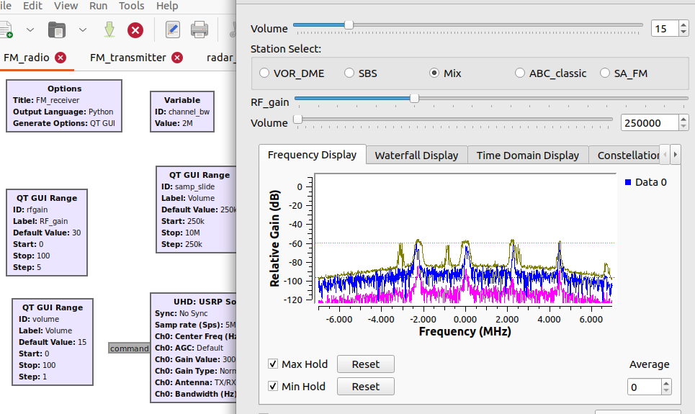
UNOFFICIAL
Recursive Receiver project
This project is aimed to investigate the potential and applications of recursive filters in EW components.
 | INFRASTRUCTURE
 | USRP B210 (Radio)
 | Laptop
 | Antennas: Log Periodic / Monopole
 | Coaxial cables
 | GNU-radio software
Figure 1. FM broadcast band Spectrum detection using GNU-radio

Slide 3
UNOFFICIAL
Recursive Receiver project
LEVEL | NAME | LoE | ALLOCATED HOURS | SPEND HOURS | SPEND TIME
Expert | Hugh Kennedy | 0.2 | 121.6 | 13 | 10.69%
Mid-level | Diego Lozano | 0.4 | 243.2 | 67.6 | 27.80%
Junior | Swapnil Srivastava | 0.5 | 364.8 | 111.5 | 30.56%
Project Timeframe (30-Jan-23 to 19-May-23)
Task Name
47.70%
Swapnil - Start
Diego - Start

Slide 4
UNOFFICIAL
PRESENTATION POINTS

Slide 5
Recursive Receiver
Personnel
Level | Name | LoE | Allocated hours | Spend hours | Spend time
Expert | Hugh Kennedy | 0.2 | 121.6 | 13 | 10.69%
Mid-level | Diego Lozano | 0.4 | 243.2 | 67.6 | 27.80%
Junior | Swapnil Srivastava | 0.6 | 364.8 | 111.5 | 30.56%
The allocated hours is based on the timeframe from 30 JAN 23 to 19 MAY 23 →(15 weeks 4 days)
Current: stage 1 – Phase 1
RF design and testing: basic digital filters, modulation/demodulation using the USRP & GNU-radio.
RF measurements, SNR, noise floor.
Reading and simulation of polyphase filter-bank (Multirate)
Implementation of a FMCW radar

Slide 6
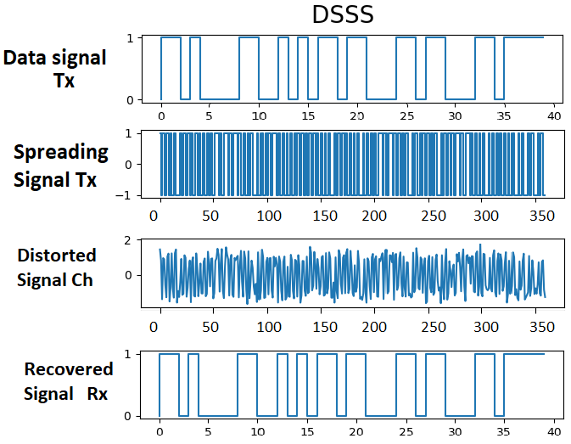
Differential LPI DSP
This project is aimed to investigate and create novel radio-techniques using machine learning. This can be accomplished by characterization transmission impairments and modeling of RF systems with auto-differentiable blocks that allow gradients to backpropagate from an objective function.
Infrastructure
Item
Desktop computer
Server
GitHub repository
Visual Studio Software
Python 3.10 programming language

Slide 7
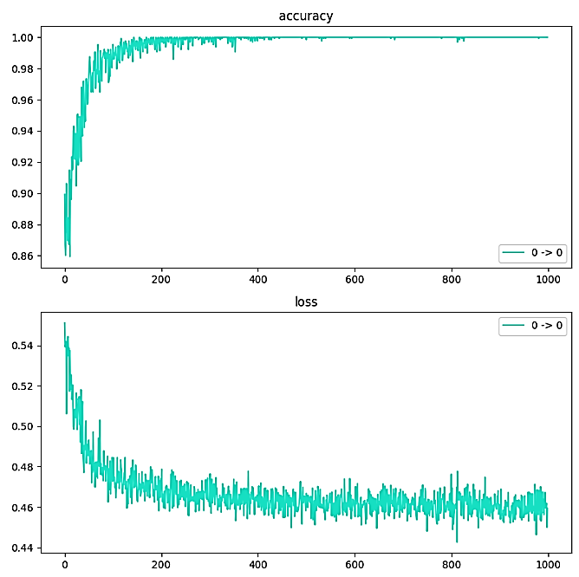
Differential LPI DSP
Personnel
Level | Name | LoE | Allocated hours | Spend hours | Spend time
Expert | Daniel Gibbons | 0.2 | 182.4 | 17.8 | 9.76%
Mid-level | Diego Lozano | 0.4 | 273.6 | 60.0 | 21.93%
The allocated hours is based on the timeframe from 06 FEB 23 to 30 JUN 23 →(20 weeks 4 days)
Current: Establish DSSS baseline
Implement the Received and transmitter DSSS @ baseline
Simulate a simple transmission with AWGN
Optimize the receiver gain based on gradients to recover the transmitted message in a simple transmission.
Add channel distortion effect and implement a new architecture.

Slide 8
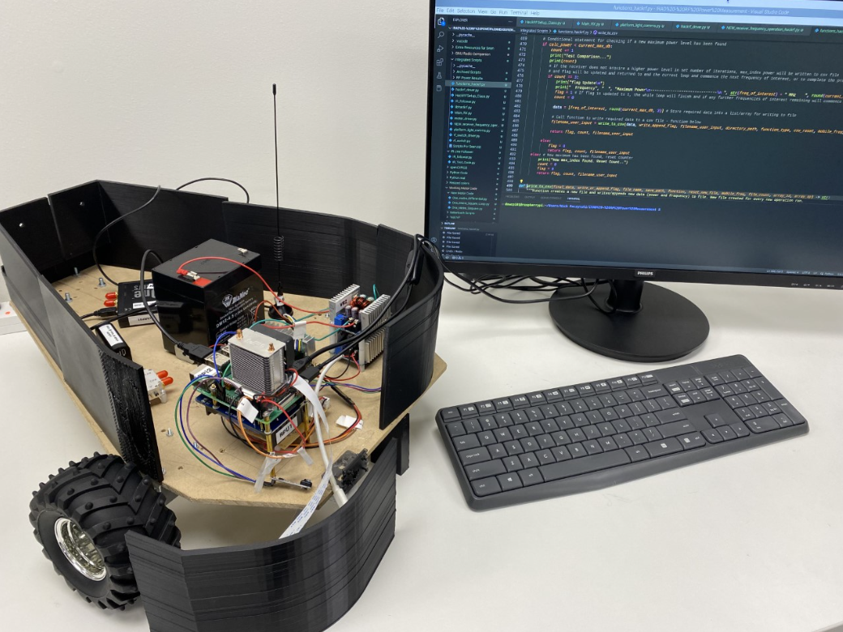
FPECM Power measurement
This project is aimed to provide automated characterization of transmitted RF energy in both angle of arrival and distance. It will then transfer the measured RF energy to usable polar plots.
Infrastructure
Item
Desktop computer & Laptop
Driving Robot & Rotating Platform
SDR: HackRF One
Antennas, LNA & RF switch
Raspberry Pi, UPS, Li-Ion Battery
GNU-radio software

Slide 9
FPECM Power measurement
Personnel
Level | Name | LoE | Allocated hours | Spend hours | Spend time
Expert | Aaron Debono | Closed | 0.5 | Closed | Closed
Expert | Aaron Logue | 0.1 | 65.5 | 66 | 100.76%
Junior | Nicholas Paczynski | 0.6 | 693 | 636.1 | 91.79%
Junior | Sean Priestley | 0.2 | 72 | 31 | 43.06%
The allocated hours is based on the timeframe from 22 AUG 22 to 31 MARCH 23 →()
Current:
Developing a final major component – Line following script using IR sensors, this script has to be compatible with the motor script. - RF components, motor drive, and the state machine are operating. He needs to refine the Python scripts, - Generate report
Getting familiar with the project and learning Python programming language. Possible challenges in developing some mechanical components.

Slide 10
Recommendations
Project traceability
Include systematic progression sub-tasks/Stages on mis or defined by project managers
Conduct a monthly/fortnightly review (Reflection) about the learned or required skills. Some team members can fill a questionary or writing 1 or 2 paragraphs about the learned or required skills.
Identify key skills needed for a particular task.
They can have benefits in the short term.
Offer diverse perspective about stage of the project
Project documentation
Create a template document with defined sections such as the abstract, background information, process & methods and findings.
It can be a dynamic document that can be continually edited and updated by all-project members.

Slide 11
Recommendations
Encourage Junior members to follow the Engineering method
 | Stage | Description
1 | Idea | Identify the problem
2 | Concept | Conduct a literature review to find existing solutions, requirements, Limitations, find the knowledge/ technology gap
3 | Planning | Define objectives, plan a program and schedule tasks (Gantt and Pert charts)
4 | Design | Translate requirements and the model into engineering specifications to design and build a working prototype models
5 | Development | Generate the engineering documentation such as schematics, source code into a prototype that demonstrates the solution to the problem.
6 | Launch | Release of the engineering design and documentation package to manufacturing facilities for production

Slide 12
Recommendations
Government Grants and Incentive
R&D Tax Incentive supported
Supported by the Australian government
Tax offset rates depends on the company aggregated turnover (Thr= $ 20 Million)

